Slide 1
FAMILY PLANNING Onyango M. Humphrey BSc.N Moi university

Slide 2
FAMILY PLANNING/ CHILD SPACING
Refers to deliberate spacing between children/ births to allow longer birth intervals.
Is the process of child spacing so that the couple has the number of children they want at the time desired i.e when wanted, expected and welcomed.
Birth spacing: time interval between two consecutive births.

Slide 3
Scope of Family Planning
A. Counselling
B. Provision of Contraceptives
C. Follow Up and Referral System
D. Record Keeping
E. Supervision
F. Logistics

Slide 4
Characteristics of Good FP Programmes
Strong government support
Well trained providers
Affordable services, which provide a wide range in the choice of contraceptive methods
Counselling
Privacy and confidentiality
Prompt service

Slide 5
Benefits of Family Planning
Enables couples and individuals to decide freely and responsibly on the number and spacing of their children, as well as on the most appropriate time of having them.

Slide 6
Benefits of family planning for women
Allows time for the body to return to its pre- pregnancy state.
They are protected against unwanted pregnancy, hence death related to high risk pregnancy and abortion is reduced.
Some methods e.g the hormonal method, have additional (non-contraceptive) benefits.
There are reduced fertility and mortality rates.

Slide 7
Advantages to the children.
Children are healthier, since the optimum spacing between births gives the mother the time to nurse and care for the infant.
Children receive adequate love & attention from the parents facilitating their emotional development.
Avoids premature weaning and malnutrition

Slide 8
Benefits to the father
Able to care for the family
Reduces socioeconomic constraints
Promotes good relationship with children and other family members.

Slide 9
Social Benefits
Improved relationship with the spouse and family due to less stress and better social life.
Socially healthy families are productive and economically more stable as they participate in community development and nation building.
Women learn to make informed choices.
The death related to infections and malnutrition to the under fives is reduced.

Slide 10
National Benefits
The country is able to budget for its citizens as the birth rate will be controlled.
Nationally reduced fertility and mortality rates lessen the burden to the nation.
If the population growth rate is higher than the economic growth rate, it creates a burden on available land, health facilities, educational resources and the job market.
These factors often impact more on mothers and children, whose mortality and morbidity rates are high

Slide 11
THE HUMAN SEXUAL RESPONSE CYCLE

Slide 12
THE HUMAN SEXUAL RESPONSE CYCLE.
Consists of four major stages, namely:
Excitement/Arousal
Plateau
Orgasm
Resolution

Slide 13
1. Excitement/arousal
Occurs as a result of physical or mental stimulation.
The body prepares for sexual intercourse
Muscle tension increases
HR and RR increases.
Increased blood flow to the genitals resulting in the swelling of the woman's clitoris and labia minora and the erection of the mans penis.
Penile erection is the first response to effective sexual arousal in the males.

Slide 14
EXCITEMENT CONT…….
Vaginal lubrication begins.
The woman's breasts become fuller and the vaginal walls begin to swell
Mans testicles swell, scrotum tightens.
Clitoral erection is a variable response in the excitement phase.
Vaginal lubrication is a more consistent response.
There is expansion of the upper vagina, and the labia minora enlarge.

Slide 15
2. Plateau phase
Phase one changes are intensified
There is a small increase in penile erection, the testes enlarge due to vascular congestion, and the scrotum contracts to draw the testes upward toward the perineum.
Ejaculation, depositing spermatozoa and seminal plasma into the posterior urethra.
Male urethral sphincter contracts to prevent urine from mixing with semen.

Slide 16
PLATEAU PHASE CONT……
Engorgement and reddening of the labia minora are characteristics of the plateau phase.
Vagina continues to swell from the increased blood flow.
Clitoris becomes extremely sensitive and the Bartholin's glands produce further lubrication.
Muscle tension increases
Increased BP HR RR.

Slide 17
3. Orgasm
Is the climax of the sexual response.
The shortest phase and lasts for a few seconds.
There is an intense subjective sensation of pleasure and release of sexual tension.
BP RR HR at the highest rate with the rapid take of oxygen.
Female orgasm produces rhythmic contractions of the perineum and reproductive organs.
Intense subjective sensations of pleasure are followed by release of general skeletal muscle tone.
Rhythmic contractions of the muscles at the base of the penis results into ejaculation.

Slide 18
4. Resolution.
The body slowly returns to its normal level of functioning.
Men need recovery time after orgasm ( refractory period) during which they cannot reach orgasm again. This period varies among men and varies with age.
Some women are capable of rapid return to the orgasm phase with further stimulation and may experience multiple orgasms.

Slide 19
RESOLUTION PHASE cont.…..
Penile detumescence (return to the flaccid state) occurs.
In women ,the resolution phase involves relaxation of the vagina and vascular decongestion of the reproductive organs.

Slide 20
PATIENT ASSESSMENT IN FP
HISTORY TAKING AND PHYSICAL EXAMINATION
(ASSIGNMENT FOR LEARNERS)
HINT: SIMILAR TO MIDWIFERY CLIENT ASSESSEMENT

Slide 21
History taking
Identifying Information
Age: Knowledge of the patient's age sets the tone for the complaint and the approach to the patient.
Last Normal Menstrual Period including LMP
The date of onset of the last normal menstrual period (LNMP) is important to define.

Slide 22
HX TAKING CT’D
Gravidity and Parity
A convenient symbol for recording the reproductive history which includes the number of term pregnancies, premature deliveries, abortions, and living children (TPAL).

Slide 23
CT’D
Chief Complaint
It is important to listen carefully to the way the patient responds to this question and to allow her to fully explain her complaint.
The patient should be interrupted only to clarify certain points that may be unclear.

Slide 24
Present illness
Each of the problems the patient describes must be obtained in detail by questioning regarding what exactly the problem is, where exactly the problem is occurring, the date and time of onset, whether the symptoms are abating or getting worse, the duration of the symptoms when they do occur, and how these symptoms are related to or influence other events in her life.

Slide 25
Contraception
It is important to elicit whether the patient is using or needs some form of contraception.
If she is using contraception, her level of satisfaction with her chosen method should be determined.

Slide 26
Medications and Habits
Any medications that are being taken or that were being taken when symptoms first occurred should be described.
Herbal preparations may not be viewed by the patient as medications, so this question should be specifically asked.
It must be ascertained whether the patient smokes and, if so, how much and for how long.
It is important to ascertain the amount of alcohol ingested, if any.
This questioning provides an ideal time to indicate the health risks of various habits.

Slide 27
medical history
It is important to discover any history of serious medical and psychiatric illnesses and whether hospitalization was required.
Particularly important are illnesses in the major organ systems.
Other important details include when she had her last physical examination, including pelvic examination and cervical screening.
Surgical
The surgical history includes all operations, the dates performed, and associated postoperative complications

Slide 28
Allergies
Questioning should continue relating any possible allergic reactions to drugs or specific foods.
The reaction produced must be elicited and the approximate time when it occurred ascertained.

Slide 29
Obstetric History
The obstetric history includes each of the patient's pregnancies listed in chronologic order.
The date of birth; sex and weight of the offspring; duration of pregnancy; length of labor; type of delivery and any complications should be included.

Slide 30
Gynecologic history
Includes:
Menstrual history: age at menarche, interval between periods, duration of flow, amount and character of flow, degree of discomfort, and age at menopause.
A prior history of sexually transmitted disease (STD) including HIV exposure needs to be detailed.
Any treatment or admissions to the hospital for treatment must be carefully documented.
Their frequency and the medications used to treat them should be discussed.

Slide 31
Sexual History
The service provider must be nonjudgmental and not embarrassed or critical.
Questions that may be covered include the following.
Is she currently sexually active?
Is the relationship satisfactory to her and, if not, why not?
A question regarding whether the patient is heterosexual or homosexual is important but often difficult to ask because the question may be offensive to some patients.
It is important, however, not to assume that a relationship is heterosexual.

Slide 32
Social HISTORY
Can be an extension of earlier questions pertaining to the marital and sexual history.
Knowing the type of work the patient does, the type of educational background, and her activities may assist in ascertaining the patient's relationship to her entire environment.
The patient's involvement with her own health care should be carefully elicited, including her attention and knowledge , health screening examinations, recreation, and the degree of regular physical exercise.

Slide 33
Family History
Must include the state of health of immediate relatives (parents, siblings and offspring).
It is useful in cases where genetic and chronic illnesses may be apparent
The incidence of familial heart disease, hypertensive renal or vascular disease, diabetes mellitus , vascular accidents, and hematologic abnormalities should be ascertained.
Familial history of breast, uterine, and ovarian cancers

Slide 34
Patient assessment/PHYSICAL EXAMINATION

Slide 35
PATIENT ASSESSMENT.
The main objective is to determine:
That the patient is not pregnant.
Whether any conditions requiring additional care for a particular method exist
Whether there are any special problems that require further assessment, treatment or regular follow up or referral
Whether there are need for HIV services and, if so, to provide the services or arrange the appropriate referral

Slide 36
You can only be reasonably sure a patient is not pregnant when she has no signs and symptoms of pregnancy and exhibits the following characteristics:
Has had no intercourse since her last menses
Is within seven days after the start of her menses (days one to seven)
Is within four weeks postpartum (for non-breast feeding women)
Is within seven days post abortion
Is fully breast feeding less than six months post partum and has had no menstrual bleeding
Has been correctly and consistently using another reliable contraceptive method.

Slide 37
Special FP/RH Procedures
General physical examination
Breast examination
Pelvic examination
Cervical cancer screening/Obtaining a Pap smear

Slide 38
The main purpose of a physical examination is:
To assess the general health status of a patient
To aid in making a diagnosis

Slide 39
Breast Examination
The physical examination provides an ideal time to ascertain the frequency and methodology of breast self-examination.
It also is an ideal time to teach the patient how to perform breast self-examination.
The examination should be repeated at the same time each month, preferably 1 week after the initiation of the menses, when the breasts are least nodular.
Postmenopausal women should perform self-examination on the same day each month.

Slide 40
Inspection
Ask the patient to undress and sit or stand relaxed in front of a mirror with good lighting.
With hands at the sides, on the waist and on the head respectively, check on the size, shape, discoloration and retraction (dimpling) of the nipple.
Turn from side to side and look underneath, push the hands inward and outwards until the chest muscles tighten.

Slide 41
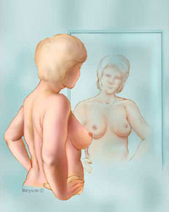
Visual Examination
While looking in the mirror
Put your arms out to the side
Put your arms above your head
Put your arms on your waist and lean forward
Changes to look for:
Dimples
Nipple changes
Redness
Leathery looking skin

Slide 42
Palpation
Ask the patient to lie down in a dorsal position on a firm surface with her head on a pillow.
Tell her to put her left hand on top of the head folded and then use the right hand to examine the left breast.
She should then reverse this to examine the right breast.
Emphasize that she should examine one breast at a time using the flat of her fingers but not the fingertips.
The fingers should be kept flat and close together.

Slide 43
Instruct her how to divide the breast into quadrants (four areas), and press gently but firmly towards the body and going round the whole breast clockwise to check for any lumps.
Show her how to examine the tail of the breast by going right up into the hollow of the armpit.
Repeat the whole process for the other breast.

Slide 44
Sequence of Breast Exam
Palpating large pendulous breasts, The inferior portion of the breast is supported in one hand while the other hand palpates breast tissue against the supporting hand
Special attention is given to palpate the nipples, and areola
Entire surface is gently palpated
With thumb and index finger compress the nipple; note any discharge.

Slide 45
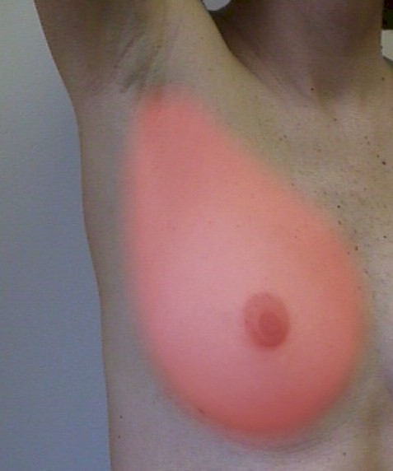
Sequence of Breast Exam

Slide 46
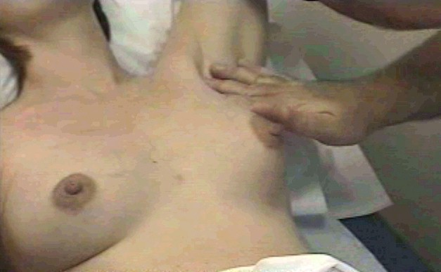

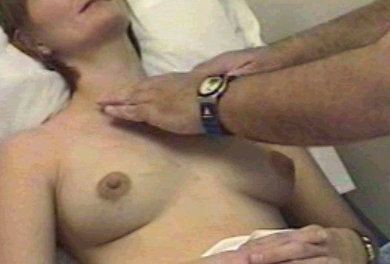

Slide 47
NOTE:
If client complains of a mass or tenderness of one breast, examine the opposite breast first to ensure an objective comparison of normal and abnormal tissue.

Slide 48
WARNING SIGNS
Unusual difference in size or shape of the breast
Alteration in the position of either nipple
Turning of colour of either nipple
Dimpling of the surface
Unusual rash on the breast or nipple
Unusual prominence of the veins over either breast or a discharge from the nipple
Unusual discrete lump or nodule on any part of either breast

Slide 49
PELVIC EXAMINATION.

Slide 50
Pelvic Examination
Pelvic examination involves exploring the female pelvic organs using hands and speculum.
The main objectives of pelvic examination are to:
Detect pelvic abnormalities that may act as a limitation to a specific contraceptive technique and for diagnosis
Identify a pathological process that may have arisen incidental to, or as a complication of, any contraceptive
Obtain specimen for laboratory studies such as cervical smear for papanicolau (Pap smear), culture and sensitivity of any bacteria / infection
Determine uterine position, shape, size, consistency
Assess the condition of uterus before removal of IUCD

